Slide 1
Activity 1

Slide 2
Scenario 1: Weekly Distribution Planning Problem
Problem type: Constrained optimization
Decision variables:
x1​: Amman
x2​: Zarqa
x3​: Irbid
x4​: Aqaba
Objective: Minimize nonlinear operational inefficiency:
Quadratic terms represent rising inefficiency with shipment volume
Cross-term models interaction between Amman and Zarqa
Constraints:
x1+x2=50x_1 + x_2 = 50x1​+x2​=50 (Amman & Zarqa)
x3+x4=60x_3 + x_4 = 60x3​+x4​=60 (Irbid & Aqaba

Slide 3
Selected Optimization Methods
Three methods were implemented and compared:
Lagrange Multiplier Method
Karush–Kuhn–Tucker (KKT) Conditions
Unconstrained Methods (Gradient & Newton) for comparison
Rationale:
Equality constraints → Lagrange & KKT are mathematically appropriate
Unconstrained methods used to verify global behavior and benchmark performance

Slide 4
Lagrange Multiplier Method
Lagrange Multiplier Method (Scenario 1)
Constructs a Lagrangian function combining:
Objective function
Equality constraints
Partial derivatives set to zero → system of equations
Solved analytically using SymPy
Strengths:
Exact solution
Guarantees constraint satisfaction

Slide 5
KKT Method
Generalized form of constrained optimization
In this problem:
Only equality constraints
KKT reduces to Lagrange conditions
Produced identical optimal solution and objective value
Advantage:
Scales to problems with inequality constraints

Slide 6
Optimal Results
Both Lagrange and KKT produced:
Same shipment quantities
Same minimum inefficiency value
Confirms:
Convex objective function
Global optimum reached
Constraint satisfaction verified exactly

Slide 7
Unconstrained Optimization (Scenario 1)
Gradient Descent and Newton’s Method applied without constraints
Observations:
Solutions violated shipment constraints
Lower objective values possible mathematically
Conclusion:
Unconstrained methods are inappropriate for this logistics problem
Constraints are essential to reflect operational reality

Slide 8
Convergence Analysis
Lagrange / KKT:
Instant convergence (analytical)
No iteration required
Gradient Descent:
Slow convergence
Sensitive to learning rate
Newton’s Method:
Very fast convergence
Requires Hessian → higher computational cost

Slide 9
Best Method Evaluation
All constrained methods achieved the same optimal objective value
Final selection based on:
Computational efficiency
Mathematical clarity
Best method:
Lagrange Multiplier
Reason:
Lowest computational cost
Exact solution
No iteration tuning required

Slide 10
Limitations
Analytical methods:
Do not scale well to large systems
Model assumptions:
Quadratic inefficiency may oversimplify real logistics behavior
Constraints assumed fixed and deterministic
Real-world uncertainty not modeled

Slide 11

Scenario 2
Problem type: Unconstrained optimization
Goal:
Minimize mean squared error (MSE)
Model:
$\hat{y}=θ_{0}+θ_{1}x_{1}+θ_{2}x_{2}+θ_{3}x_{3}+θ_{4}x_{4}+θ_{5}x_{5}$

Slide 12
Method Selection: Gradient Descent
Chosen method: Gradient Descent
Reasons:
Objective is differentiable
High-dimensional parameter space
Closed-form solution not required
Widely used in machine learning
Iterative improvement toward minimum error

Slide 13
Gradient Descent Implementation
Steps:
Initialize parameters
Compute gradients of MSE
Update parameters iteratively
Learning rate controls step size
Iterations continued until convergen

Slide 14
Convergence Behavior
Error decreased monotonically
Convergence observed after multiple iterations
Learning rate selection was critical:
Too large → divergence
Too small → slow convergence

Slide 15
Newton’s Method
Newton’s Method was implemented to minimize prediction error
Reasons for selection:
Objective function is twice differentiable
Hessian matrix exists and is constant
Guarantees fast convergence

Slide 16
Convergence Analysis
Observed behavior:
Quadratic convergence
Rapid reduction in MSE
Compared to Gradient Descent:
Fewer iterations
Higher per-iteration cost

Slide 17
Objective Function Performance
Both Gradient Descent (GD) and Newton’s Method reached the same minimum objective function value, confirming convergence to the global optimum.
This is expected since the objective function is convex and quadratic.

Slide 18
Convergence Behavior
Gradient Descent:
Convergence depends strongly on the learning rate.
Required significantly more iterations to reach the minimum.
The best learning rate observed was:
α=0.01
Smaller values caused slow convergence, while larger values led to instability.
Newton’s Method:
Exhibited quadratic convergence.
Reached the optimum in very few iterations.

Slide 19
Computational Efficiency
Gradient Descent:
Low computational cost per iteration.
No Hessian computation required.
Newton’s Method:
Higher computational cost due to Hessian inversion.
More efficient overall for small parameter spaces.
Best Method Selection
Since both methods achieved the same objective value, the selection depends on efficiency.
Newton’s Method is the best method for this scenario due to:
Faster convergence
Fewer iterations
Small number of parameters

Slide 20
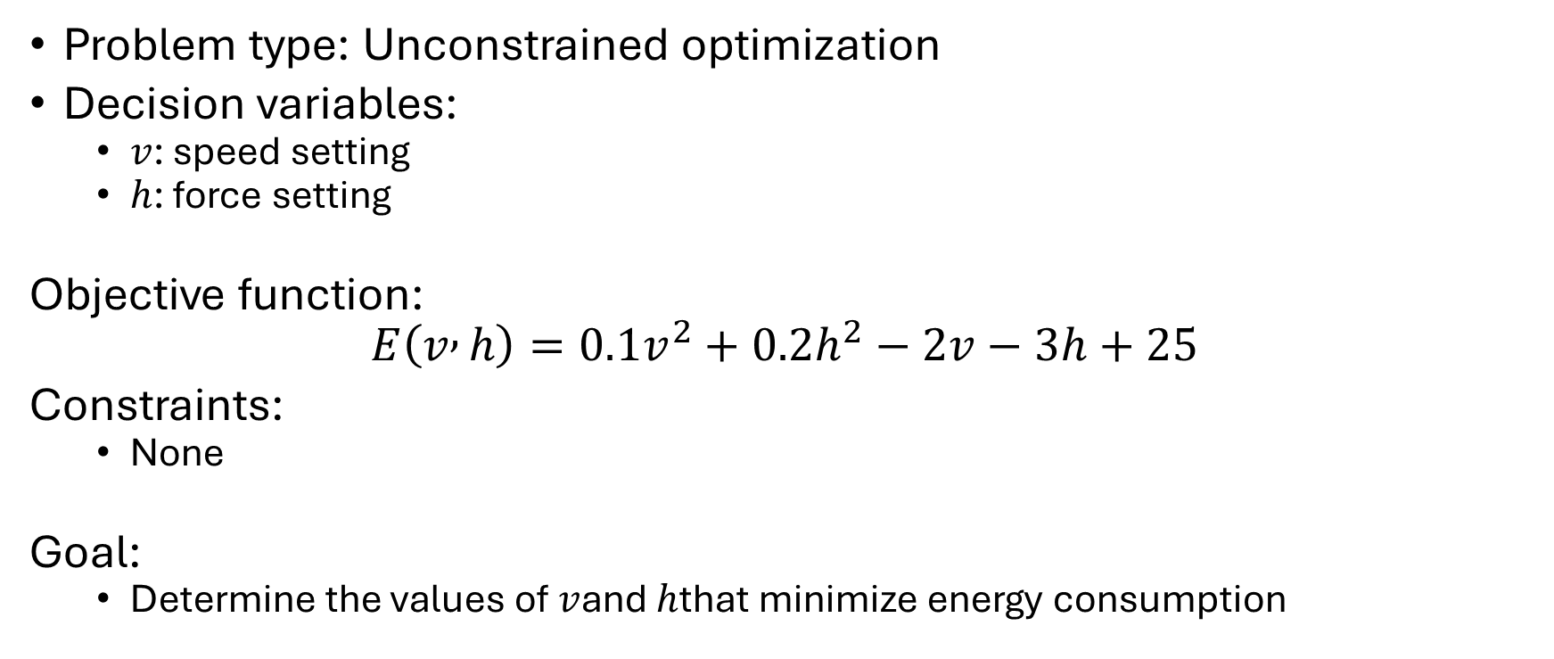
Scenario 3
Problem type: Unconstrained optimization
Decision variables:
$v$: speed setting
$h$: force setting
Objective function:
$$E\left(v , h\right)=0.1v^{2}+0.2h^{2}−2v−3h+25$$
Constraints:
None
Goal:
Determine the values of $v$and $h$that minimize energy consumption

Slide 21
Gradient Descent Method
Advantages:
Simple implementation
Low computational cost per iteration
Disadvantages:
Convergence depends on learning rate
Requires many iterations
Iterative first-order optimization method
Uses:
Gradient of the objective function
Advantages:
Simple implementation
Low computational cost per iteration
Disadvantages:
Convergence depends on learning rate
Requires many iterations

Slide 22
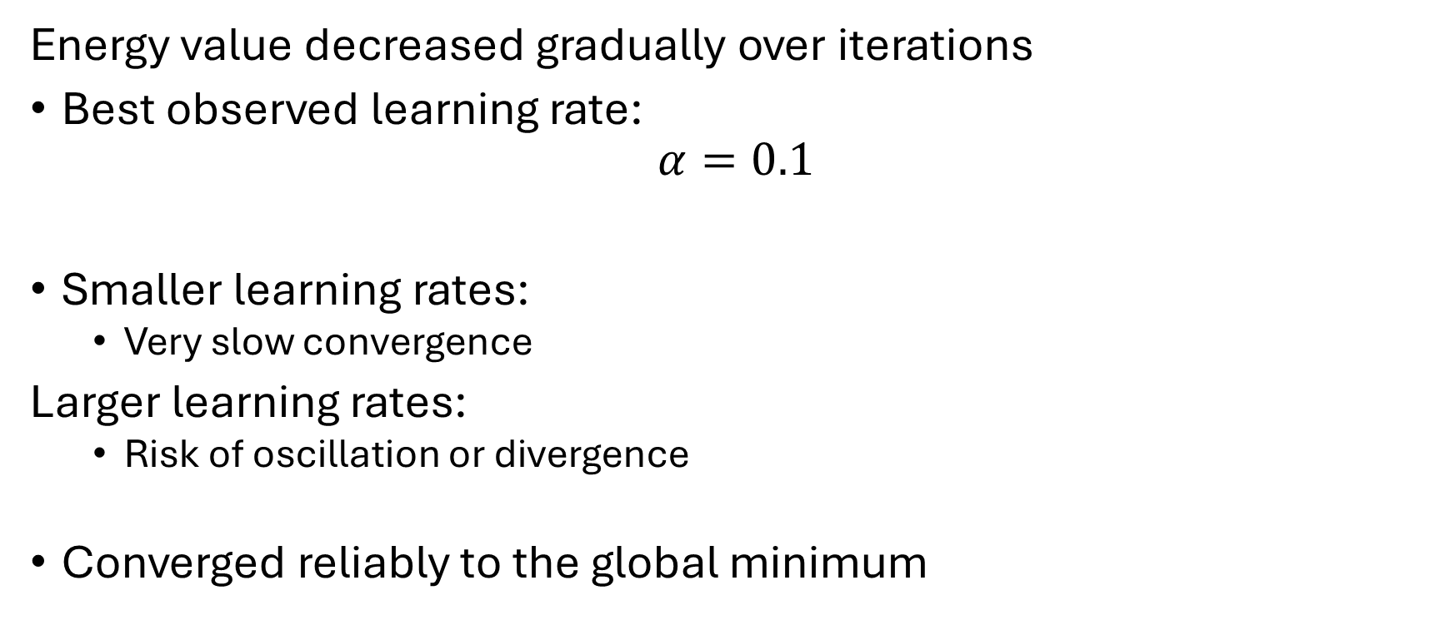
Gradient Descent Convergence Behavior
Energy value decreased gradually over iterations
Best observed learning rate:
$$α=0.1$$
Smaller learning rates:
Very slow convergence
Larger learning rates:
Risk of oscillation or divergence
Converged reliably to the global minimum

Slide 23
Newton’s Method
Second-order optimization method
Uses:
Gradient vector
Hessian matrix
Particularly suitable for quadratic functions
Hessian is constant and positive definite

Slide 24
Newton’s Method Convergence Behavior
Converged in very few iterations
Exhibited quadratic convergence
Achieved minimum energy almost immediately
More computationally expensive per iteration
No learning rate tuning required

Slide 25
Optimal Solution
Both methods produced the same optimal solution:
Optimal speed
Optimal force
Confirms:
Convexity of the objective function
Correct implementation of both methods

Slide 26
Gradient Descent vs Newton’s Method
Objective Function Result
Both methods reached the same minimum energy value
Convergence Speed
Gradient Descent:
Slow, iteration-dependent
Best learning rate=0.1

Slide 27
Cont
Newton’s Method:
Very fast convergence
Fewer iterations
Computational Cost
Gradient Descent:
Low per iteration
Newton’s Method:
Higher per iteration due to Hessian inversion

Slide 28
Best Method Selection
Since both methods achieved the same objective value, method selection depends on efficiency
Newton’s Method is the best method for this scenario because:
Objective function is quadratic
Hessian is constant
Fastest convergence with minimal iterations
Gradient Descent remains useful for large-scale problems

Slide 29
Optimization Testing Results & Evaluation Activity 2

Slide 30
Activity 2
Activity 2 evaluates metaheuristic optimization algorithms for:
Feature selection
Hyperparameter tuning
Algorithms tested:
Particle Swarm Optimization (PSO)
Grey Wolf Optimizer (GWO)
Genetic Algorithm (GA)
Evaluation based on:
Objective function value
Convergence behavior
Stability across runs

Slide 31
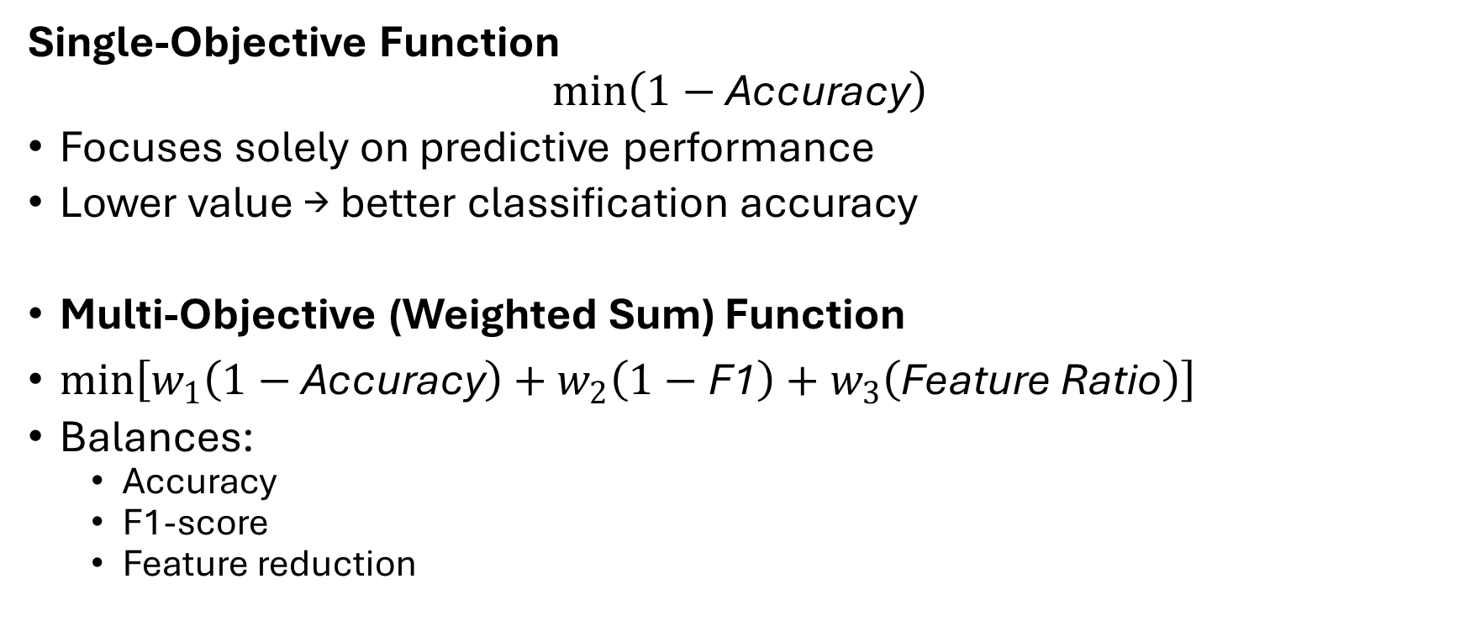
Objective Functions Used
Single-Objective Function
$$min⁡\left(1−\text{Accuracy}\right)$$
Focuses solely on predictive performance
Lower value → better classification accuracy
Multi-Objective (Weighted Sum) Function
$\min\left[w_{1}\left(1−\text{Accuracy}\right)+w_{2}\left(1−\text{F}\text{1}\right)+w_{3}\left(\text{Feature} \text{Ratio}\right)\right]$
Balances:
Accuracy
F1-score
Feature reduction

Slide 32
Boxplot Analysis (Single Objective)
PSO
Lowest median objective value
Small variance → stable performance
GWO
Wider spread
Less consistent convergence
GA
Higher objective values
More variability
Interpretation
PSO achieves the best accuracy consistently
GA shows weaker exploitation capability

Slide 33
Convergence Analysis (Single Objective)
PSO
Gradual but steady improvement
Converges to the lowest fitness value
GWO
Fast initial convergence
Early stagnation
GA
Rapid early drop
Plateaus at a higher fitness
Conclusion
PSO provides the best final solution
GWO and GA suffer from premature convergence

Slide 34
Boxplot Analysis (Multi-Objective)
GWO
Lowest median objective value
Best balance between accuracy and feature reduction
PSO
Competitive but slightly higher objective
GA
Highest objective and variance
Interpretation
GWO handles multi-objective trade-offs more effectively
GA struggles with balancing conflicting objectives

Slide 35
Convergence Analysis (Multi-Objective)
GWO
Fast convergence
Stable final objective value
PSO
Slower convergence
Slightly higher final fitness
GA
Step-like improvements
Late stagnation
Conclusion
GWO is more efficient for multi-objective optimization

Slide 36
Algorithm Comparison Summary
Algorithm | Single Objective | Multi Objective | Stability
PSO | Best | Good | High
GWO | Moderate | Best | Moderate
GA | Weak | Weak | Low

Slide 37
Limitations
Metaheuristic methods:
No guarantee of global optimality
Performance depends on parameter tuning
Weighted-sum approach:
Sensitive to weight selection
Computational cost increases with:
Population size
Number of iterations

Slide 38
Proposed Improvements
Adaptive parameter control for PSO and GWO
Dynamic weight adjustment in multi-objective function
Hybrid approach:
Metaheuristics + local search
Early stopping based on convergence stagnation

Slide 39
PSO testing and improvements
Activity 3

Slide 40
Purpose of PSO Testing Code
Verify correctness of PSO implementation
Track particle updates per iteration
Validate exploration and exploitation behavior
Enable step-by-step numerical verification

Slide 41
PSO Parameters
Velocity limit: Vmax = 6
Inertia bounds: wMax = 0.9, wMin = 0.2
Cognitive coefficient: c₁ = 2 personal best
Social coefficient: c₂ = 2 global best

Slide 42
Initialization Phase
Velocities initialized to zero
Positions randomly initialized within bounds
Personal best scores initialized to infinity
Global best initialized to infinity

Slide 43
Initial Population Inspection
Initial positions printed
Initial velocities printed
Confirms correct random initialization

Slide 44
Objective Function Evaluation
fitness = objf(pos[i, :])
Evaluates full decision vector
Returns scalar fitness value

Slide 45
Fitness Definition for Classification
Fitness = 1 − Accuracy
Lower fitness → better solution
Converts maximization problem into minimization
Guides PSO search

Slide 46
PSO Update Equations
Velocity equation :
Vij (t+1) = W*Vij(t) +c1 * r1 * (pBest - x) + c2 * r2 * (gBest - x)
Position equation:
Xij(t+1) = Xij(t) + Vij(t+1)

Slide 47
Initial Population (Iteration 0)
Initial population
Population size = 2
Dimensions = 28
Velocity initialized to zero

Slide 48
Initial Population (Iteration 0)
Particle 0 (dimension 0)
X0(0) = 0.5798069
V0(0) = 0
Particle 1 (dimension 0)
X0(0) = 0.0173868
V0(0) = 0

Slide 49
Fitness Evaluation – Iteration 1
Run results:
Particle 0 fitness = 0.187
‘Particle 1 fitness = 0.220
Therfore:
Particle 0 becomes pBest0 and gBest

Slide 50
Manual PSO Update – Particle 0 (dimension 0)
X(0) = 0.5798069
V(0) = 0
pBest = x(0)
gBest = x(0)
r1 = 0.12797
R2 = 0.10819
W = 0.9
Velocity calculation:
V(1) – 0.9(0) + 2*r1(0) + 2*r2(0) = 0
Position update calculations:
x(1) = 0.5798069 + 0 = 0.5798069

Slide 51
Verification
Quantity | Manual | Run results
(v(t+1)) | 0.0000000 | 0.0000000
(x(t+1)) | 0.5798069 | 0.5798069

Slide 52
Manual PSO Update – Particle1 (dimension 0)
X(0) = 0.0173868
V(0) = 0
pBest = x(0)
gBest = x(0)
r1 = 0.68269
R2 = 0.43250
W = 0.9
Velocity calculation:
V(1) = 2(0.43250)(0.5798069 - 0.0173868)
V(1) = 0.0173868
Position update calculations:
x(1) = 0.0173868 + 0.4864988 = 0.5038855

Slide 53
Verification
Quantity | Manual | Run results
(v(t+1)) | 0.4864988 | 0.4864988
(x(t+1)) | 0.5038855 | 0.5038855

Slide 54
Verification across iterations
Iter | Particle | (x(t)) | (v(t)) | (x(t+1))
1 | 1 | 0.01739 | 0.00000 | 0.50389
2 | 1 | 0.50389 | 0.48650 | 0.86168
3 | 1 | 0.86168 | 0.35779 | 0.81829
4 | 1 | 0.81829 | −0.04339 | 0.74494

Slide 55
Testing observations:
PSO implementation was first tested and verified mathematically
Runtime behavior of particles was carefully observed
Testing revealed limitation in exploration and convergence

Slide 56
Observed during PSO testing
Some particles remained stationary for multiple iterations
Global best particle dominated early
Inertial weight behaved the same regardless of the optimization progress
The weights of the c1 and c2 are constant

Slide 57
First issue
From testing outputs:
1. certain particles showed :
1- no change in position
This behavior is mathematically correct but reduces swarm diversity

Slide 58
Stagnation impact o
Loss of exploration
Reduces chance of discovering better solutions
High risk of stuck on local minima

Slide 59
Second issue (fixed inertial schedule)
Old inertia weight
W(t) = Wmax – t*(Wmax - Wmin)/t

Slide 60
Summary of problems
Issue | Evidence from Testing
Particle stagnation | No position updates
Early convergence | Fitness stopped improving
Rigid exploration control | Fixed inertia decay

Slide 61
Improvements strategy
1. adaptive inertia weight
2. improving exploration

Slide 62
Adaptive inertia
W(t) = Wmax + (Wmax - Wmin)* f(t)/f(0)
f(t): current global best fitness
f(0): initial global best fitness

Slide 63
Why adaptive inertia improved the results
Inertia stayed high when fitness stagnated
Exploration was preserved longer
Exploitation stayed as it is

Slide 64
Improvement 2: if there is no improvement detected
Solution: reset particle position randomly
Its benefits:
Prevents particle freezing
Forced exploration of new regions
Restores unimproved particles

Slide 65
Original vs improved PSO
Aspect | Original PSO | Improved PSO
Inertia weight | Linear decay | Fitness-adaptive
Exploration control | Fixed | Dynamic
Stagnation handling | None | Re-initialization

